Slide 1
ENFitTM Compatible
Enteral Feeding Tube Products
Update
UVACH Center of Nursing Excellence
Adapted from work compiled by UVA Main Ty Ashworth, RN, BSN, CMSRN

Slide 2
ENFitTM Updates
Background: In 2022 UVA Health prepared to transition feeding tube products to ENFit compatible products/devices.
Misconnections with enteral feeding products resulted in GEDSA (Global Enteral Device Supplier Association) creating a unique, standardized enteral feeding connection. This transition is not specific to UVA, but impacts the globe.
Global supply chain complications, insufficient supply, and increased demand have resulted in a prolonged, piecemeal transition.

Slide 3
ENFitTM Updates
Who: All patients with an enteral feeding tube
What: ENFit compatible = ‘Twist-in/Locking’ function
Where: Ultimately will impact all enteral tubes
Why: Improves safety:
Decreases risk of misconnections to other lines/devices (i.e. ENFit only connects to ENFit)
Decreases likelihood of disconnections
Standardization → Universal connector
When: Ongoing

Slide 4
ENFitTM Updates
What do we currently have…?
Some products are already ENFit compatible
Kangaroo feeding tubing sets
Tube Feeding Bag (Bin# 90850)
Feed Spike w/ Flush (Bin# 90848)
Feed Tube Spike (Bin# 90847)
Tube Feeding Bag w/ Flush (Bin# 90846)

Slide 5
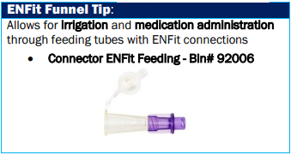
ENFitTM Updates
Transition Connectors – Stocked August 2023
Legacy → ENFit
ENFit → Legacy

Slide 6
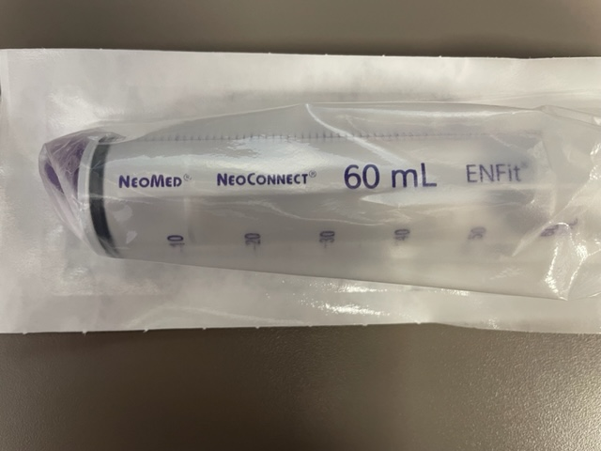
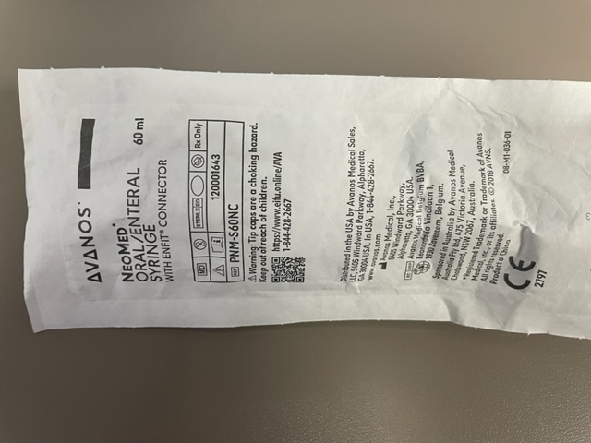
ENFitTM Updates
ENFit Syringes – *Coming September, 2023
Adults: 60 mL syringe (Bin# 97805)
60 mL and 12 mL syringes

Slide 7
ENFitTM Updates
ENFit Syringes – Practice implication?
ENFit → ENFit vs… (syringe)
Legacy → ENFit (syringe, cath tip, transition connector)
50 mL syringe (Bin: 97144)
Cath Tip Adapter (Bin: 92185)
Enteral Funnel ENFit Transition Connector with cap (Bin: 99817)

Slide 8
ENFitTM Updates
ENFit CO₂ Colorimetric Device – *Coming September, 2023
Practice implication?
Use ENFit colorimetric CO2 detectors only with ENFit tubes needed for provider placement in areas without fluro guidance (ICU/CCU)

Slide 9
ENFitTM Updates
What can I do in the meantime to educate my practice area?

Slide 10
ENFitTM Updates
Educational Videos from UVA Main!
Enteral Tube Insertion (~ 3 minutes)
Kristi (Kimpel) Wilkins
Adult Enteral Devices & Supplies (~ 6 minutes)
Kristi (Kimpel) Wilkins
Children’s Hospital Enteral Devices & Supplies (~ 3 minutes)
Susan Wetherall
Loop in unit leaders and shift managers

Slide 11
ENFitTM Updates
NPGO Resources page
QR Codes (Use local VMBs)
Videos (w/ QR codes)
More to come, including…
FAQ
Product Reference Visual Guide (in supply room)
Positive Takeaway…?
Once a team member performs this once, they typically grasp the key concepts/takeaways.

